Slide 1





Introduction to
Clustering (Unsupervised Learning)
Copyright © Cognitior
www.cognitior.com

Slide 2
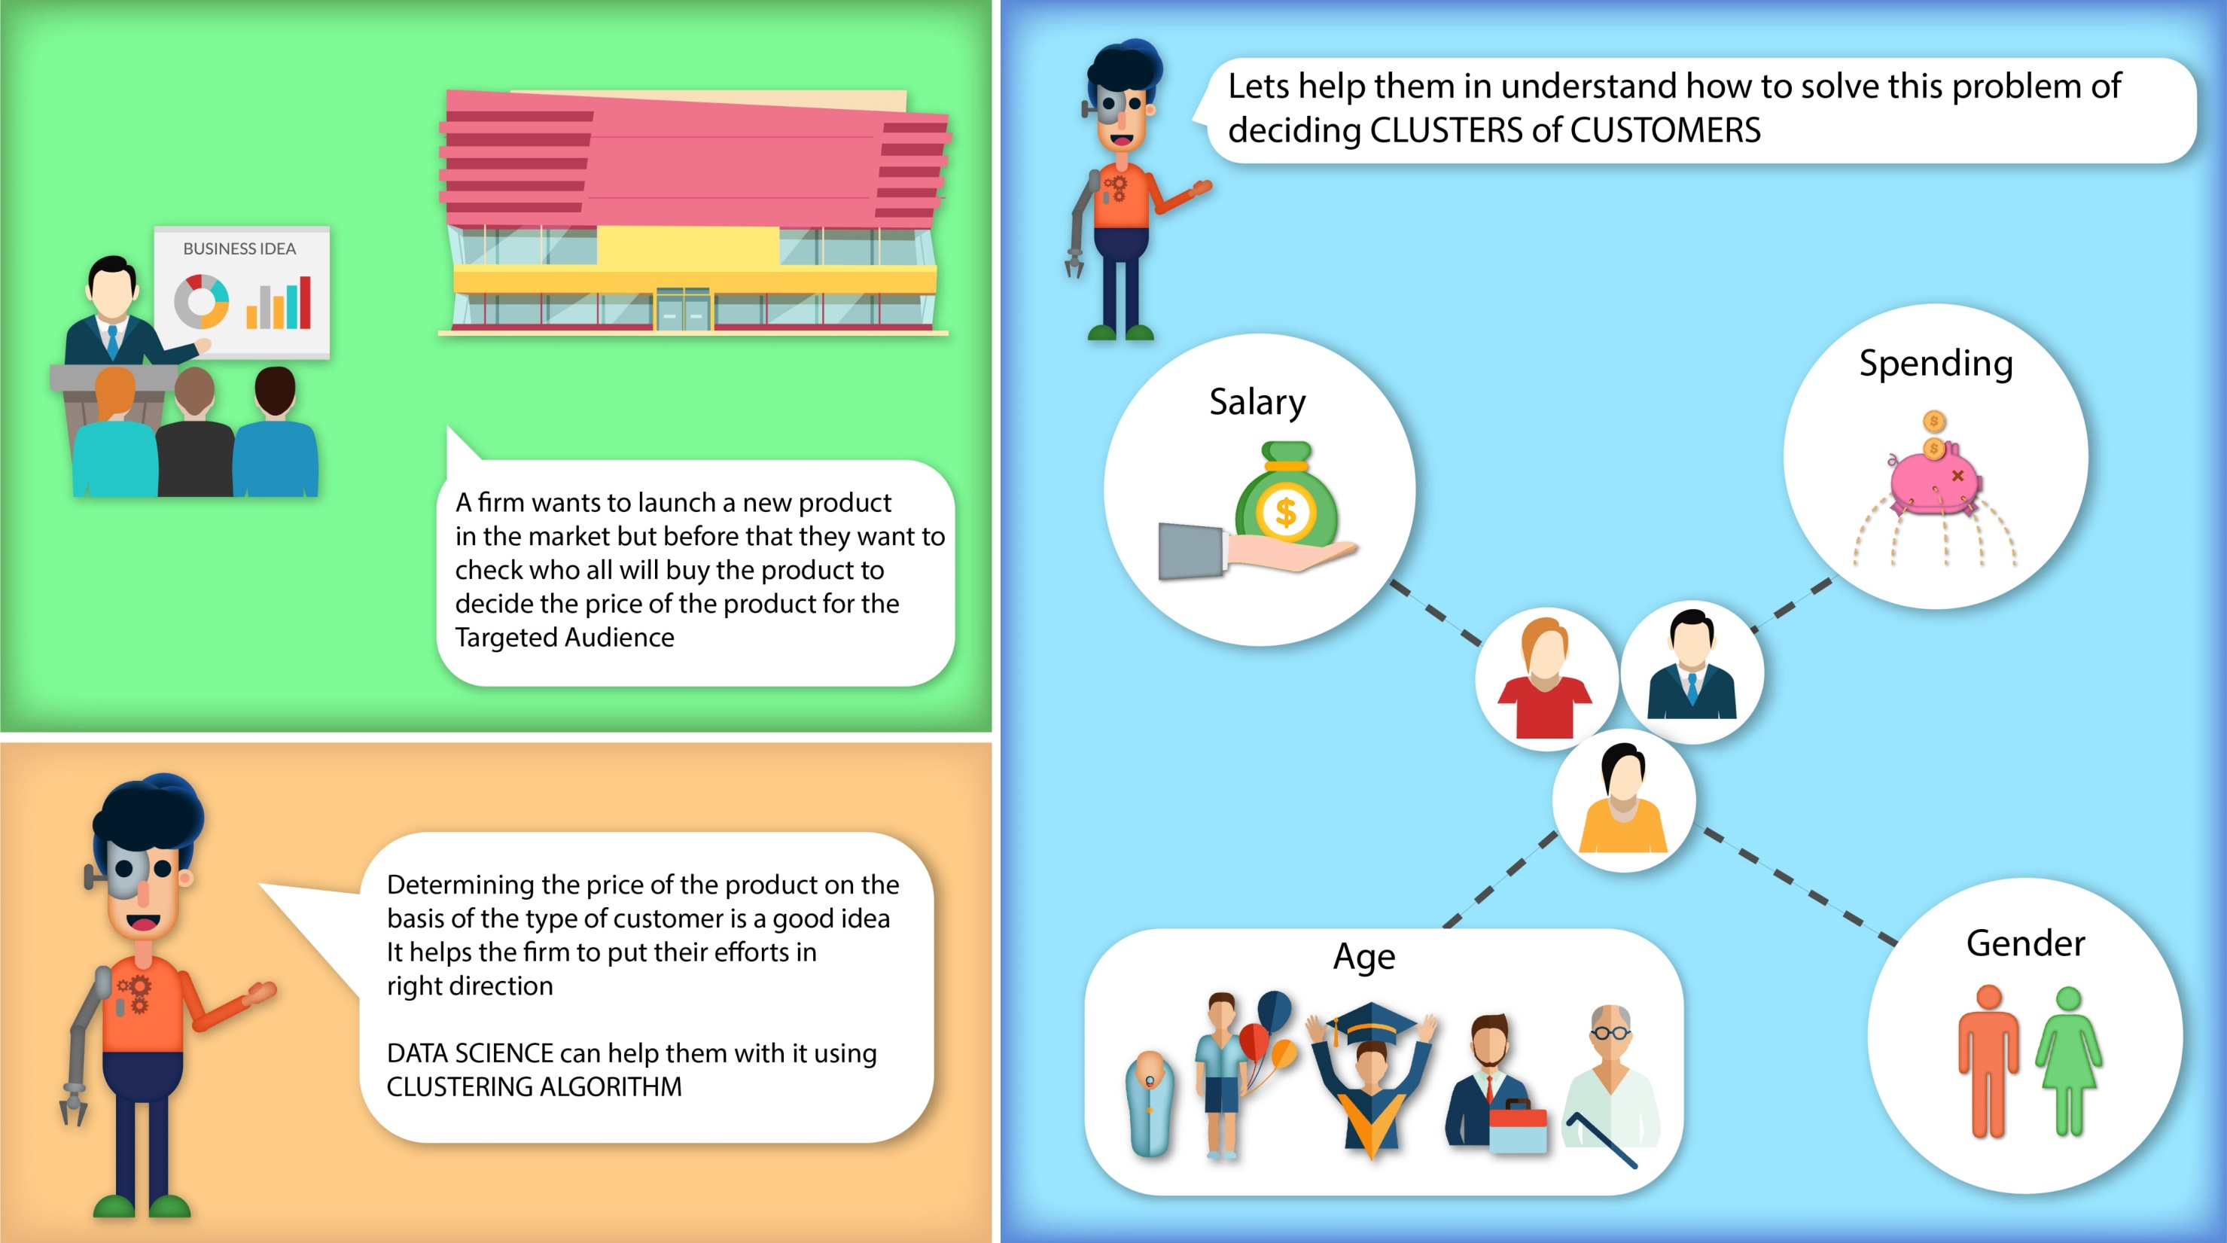


Slide 3
Introduction to
Euclidean Distance
Copyright © Cognitior
www.cognitior.com

Slide 4
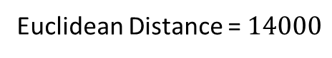
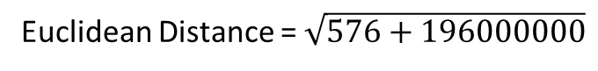

What is a Euclidean distance – An Intuition
State | Age | Salary | Purchase
California | 21 | 21000 | No
Texas | 25 | 25000 | No
Arizona | 23 | 25000 | Yes
Utah | 33 | 30000 | Yes
California | 45 | 35000 | Yes
California | 25 | 23000 | No
Texas | 26 | 27000 | Yes
Arizona | 27 | 29000 | No
Texas | 30 | 32000 | No
Texas | 32 | 31000 | Yes
Utah | 33 | 35000 | Yes
Utah | 34 | 40000 | Yes
Texas | 36 | 42000 | Yes
Texas | 34 | 35000 | No
Euclidean Distance = $\sqrt{{(X_{2}−X_{1})}^{2}+({Y_{2}−Y_{1})}^{2}}$
$$(X2,Y2)$$
Euclidean Distance = $\sqrt{{(45−21)}^{2}+({35000−21000)}^{2}}$
Euclidean Distance = $\sqrt{576+196000000}$
Salary
Euclidean Distance = $14000$
$$(X1,Y1)$$
Age
Copyright © Cognitior
www.cognitior.com
Notes:
Missing data in the training data set can reduce the power / fit of a model or can lead to a biased model because we have not analysed the behaviour and relationship with other variables correctly. It can lead to wrong prediction or classification.

Slide 5
Introduction to
Kmeans Clustering
Copyright © Cognitior
www.cognitior.com

Slide 6
K-Means – An Intuition
Salary
Euclidean Distance
Elbow Joint - Ideal clusters
Spending Score
# Clusters
Copyright © Cognitior
www.cognitior.com

Slide 7
K-Means – An Intuition
Salary
Spending Score
Copyright © Cognitior
www.cognitior.com

Slide 8
Introduction to
Hierarchical Clustering
Copyright © Cognitior
www.cognitior.com

Slide 9
Hierarchical – An Intuition
P6
P5
P7
Salary
P2
Euclidean Distance
P1
P4
P3
Spending Score
# Points
Copyright © Cognitior
1
2
3
4
5
6
7
www.cognitior.com

Slide 10
Introduction to
Silhouette Analysis
Copyright © Cognitior
www.cognitior.com

Slide 11
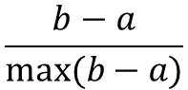
Silhouette Analysis – An Intuition
Call it as b
$$\frac{b−a}{max⁡(b−a)}$$
Mean Distance
Call it as a
Mean Overspeed
Copyright © Cognitior
www.cognitior.com

Slide 12

Introduction to
Lithium Power
Copyright © Cognitior
www.cognitior.com

Slide 13
Lithium Power is the largest provider of electric vehicle(e-vehicle) batteries. It provides battery on a rental model to e-vehicle drivers.
Drivers rent battery typically for a day and then replace it with a charged battery from the company.
Lithium Power has a variable pricing model based on driver's driving history.
As the life of a battery depends on factors such as over speeding, distance driven per day etc.
You as a ML expert have to create a cluster model where drivers can be grouped together based on the driving data.
Drivers will be incentivized based on the cluster, so grouping has to be accurate
Copyright © Cognitior
www.cognitior.com

Slide 14
Thank You!!!
Any Questions?
support@cognitior.com
Copyright © Cognitior
www.cognitior.com

